Slide 1
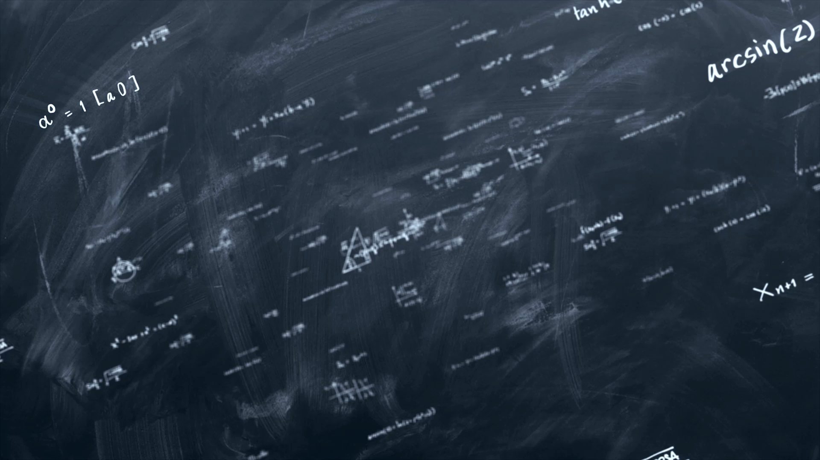
Concurrency asynchronous functions and
Practices Modern Programming

Slide 2

Multithreading

Slide 3
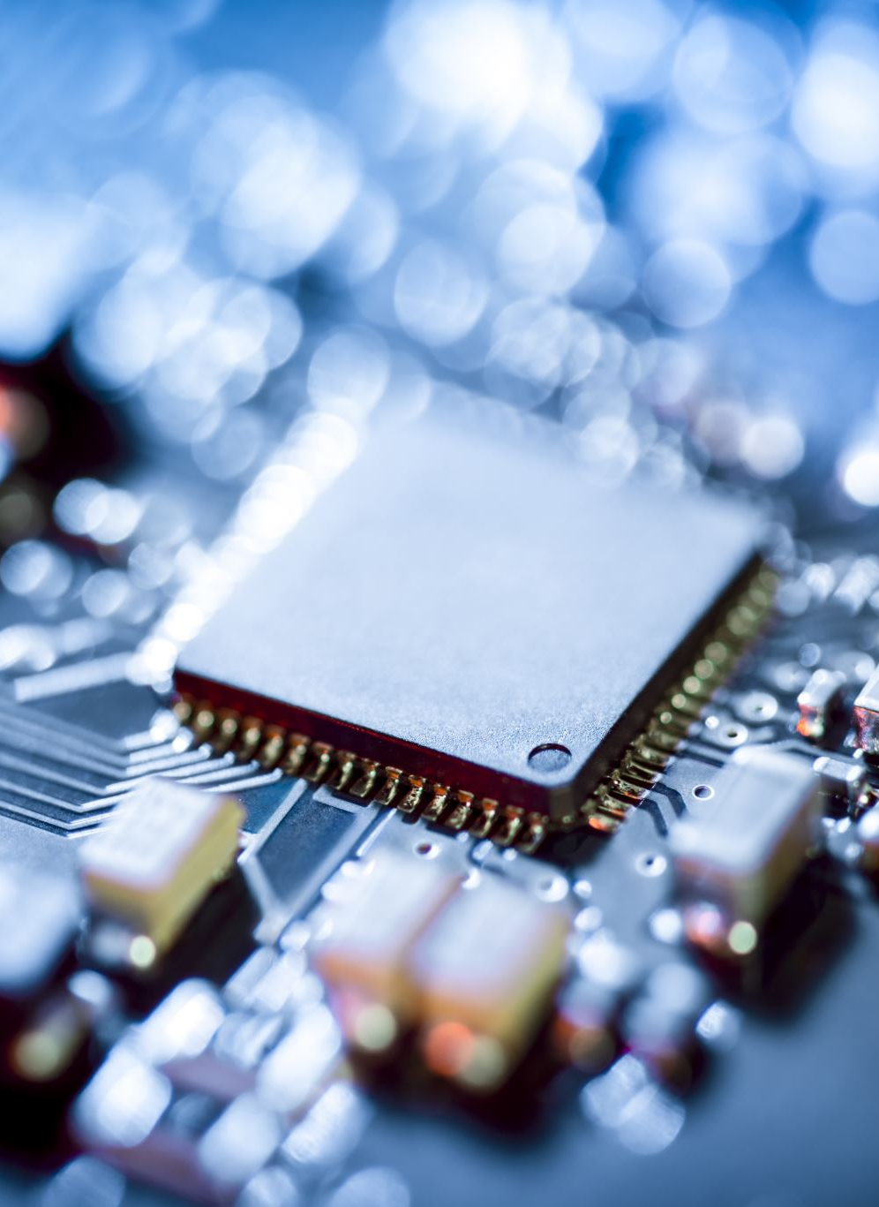
Back to basics
Computer consists of hardware
Cpu is the “brains”
CPU?

Slide 4
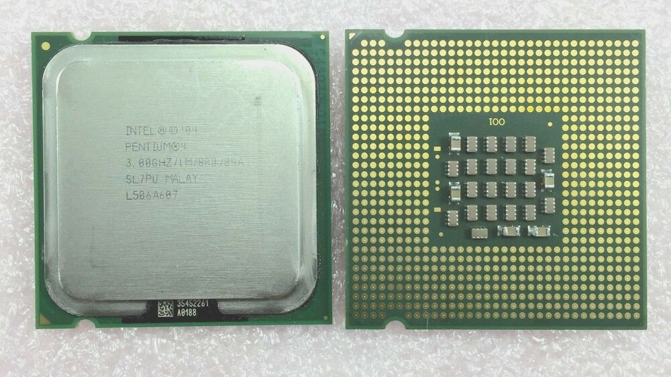
Back to basics
Central Processing Unit

Slide 5
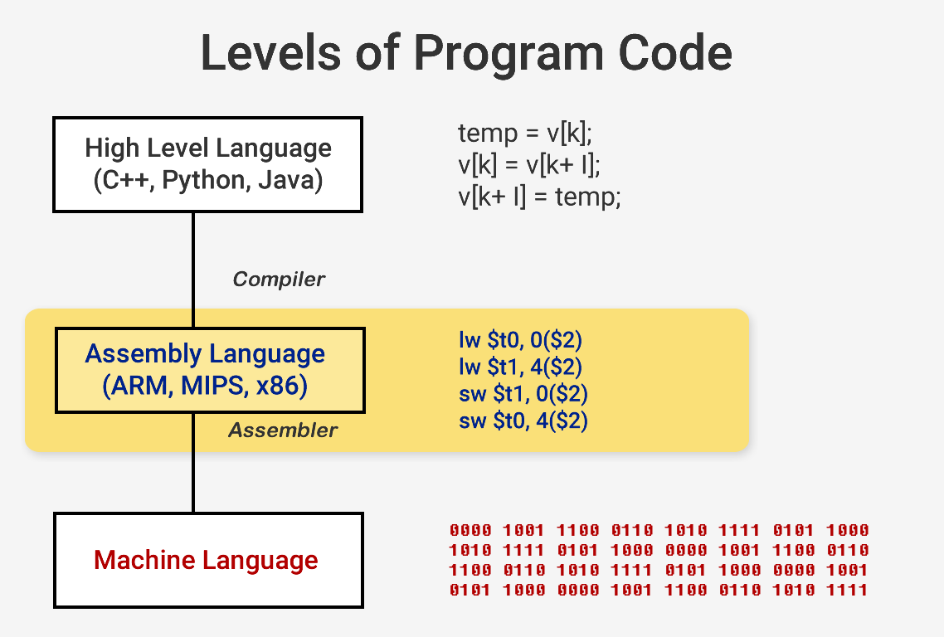
Software to code

Slide 6
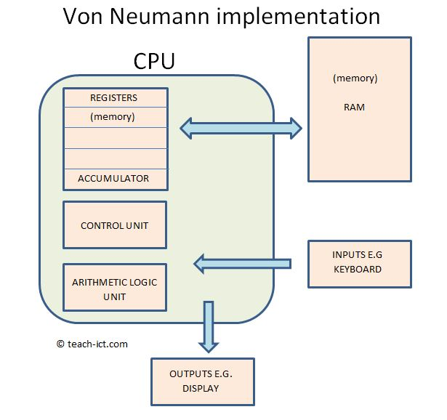
Code to output

Slide 7
Demo
“Little Man Computer”
Simple program:
Sum 2 random inputs

Slide 8
Pseudocode
var a = input()
var b = input()
print(a + b)
https://peterhigginson.co.uk/lmc/

Slide 9
But, what makes the code run?

Slide 10

Operating system

Slide 11
Processes
A program is run as a “process”
Each component of that program is a “thread”
A Thread is the smallest piece of a program than can be run independently

Slide 12
Multitasking
1 CPU can only run 1 thing at a given time
What is this “thing”?

Slide 13
Multitasking
1 CPU can only run 1 thing at a given time
What is this “thing”?
Thread

Slide 14
Multitasking
CPU switches processes after completing a thread
When switching fast enough: illusion of multitasking

Slide 15
https://www.cpubenchmark.net/

Slide 16
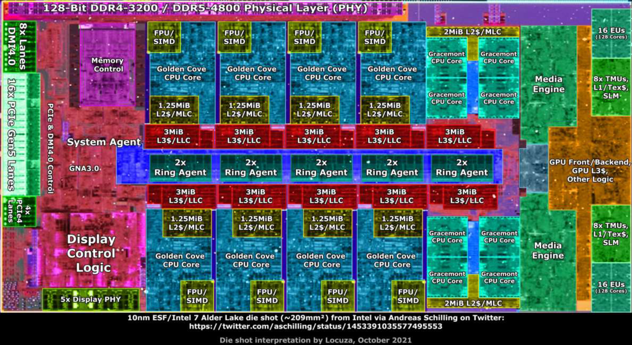
Innovation
Multicore processor
More processing core
More threads
More simultaneous things running

Slide 17
Moar!
Concurrency
Parallel

Slide 18

We will do
Concurrency
And not parallel

Slide 19
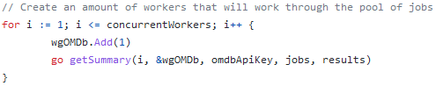
Concurrency in Go
Literally “go ” in front of a function call
That’s it ☺

Slide 20
Rob Pike
Co-author of Unix, UTF-8 en Golang
https://blog.heroku.com/concurrency_is_not_parallelism
Slides: https://talks.golang.org/2012/waza.slide

Slide 21

Video
Between 11:00 and 12:00 is part of the assignment
Input -> burning pile = HTTP request
Burning pile -> incinerator = database transaction
Amount of gophers is the amount of goroutines
“If anything about this talk sinks in, it’s to read this paper”: https://www.cs.cmu.edu/~crary/819-f09/Hoare78.pdf

Slide 22

Let’s play

Slide 23
5 min
The game is Texas hold-em
You will hand out cards
Think up multiple strategies to divide cards
There are 6 players
Each player needs 2 cards

Slide 24
1 card each per round
2 card each in a round
Use all hands
Give cards per group of players
Give cards randomly until they have 2
Pass the deck
Put the cards in the middle and free for all
Clone yourself
Buy a shuffle machine on Temu

Slide 25
Hand out card for card
Hand out 2 cards at same time
Grow 10 more hands and deal 12 of them at once
Overengineer a table to that the table gives cards
Setup instructions so that every player get their own cards after a set downtime
Give 1 player cards, and let the players pass the card until the next player has 2 cards
Throw cards in the middle and FFA
Make matrix of cards and RNG it out
Lottery system with a spinning wheel

Slide 26
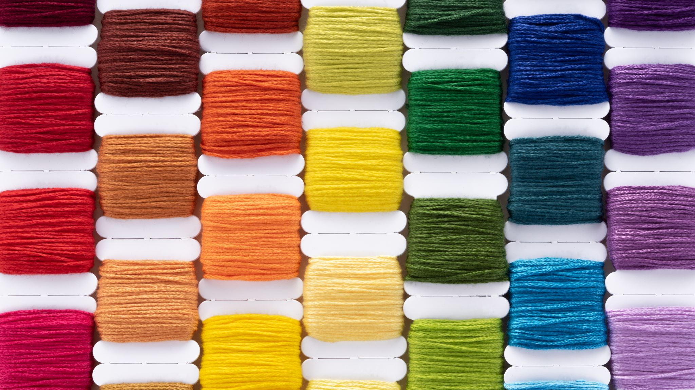
Q&A
Can we decompose this problem into multiple threads?

Slide 27


Slide 29

Is this useful?

Slide 30


Slide 31


Slide 32

This is just…
Synchronous code executing sequentially

Slide 33
Risk of
Deadlock (aka Windows 95)
Segfault
When multiple threads keep waiting on each other eternally
When a thread tries to access memory that is currently in use by another thread

Slide 34
Communicating
Threads can solve this by communicating
But this is… hard
As we know: every problem ever was caused by miscommunication

Slide 35
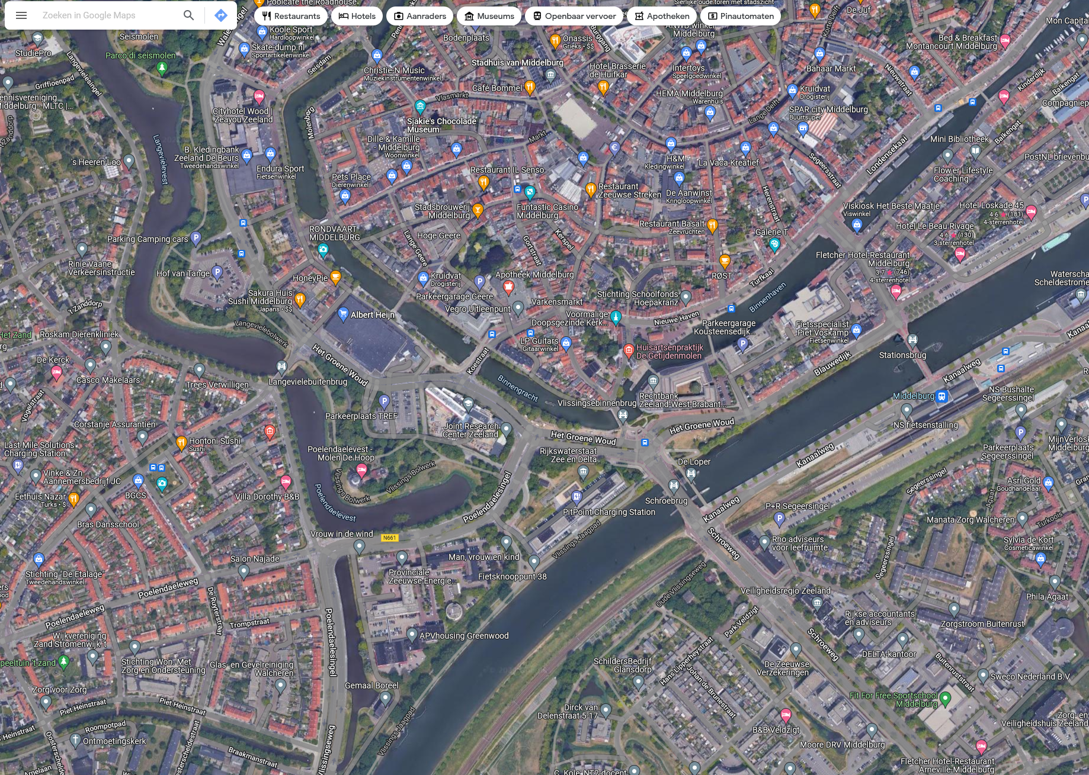
Communication between Goroutines

Slide 36
But…
If your problem is non-deterministic
Non = not
Deterministic = exact same steps lead to exact same result
Then you can use concurrency without real issues!

Slide 37
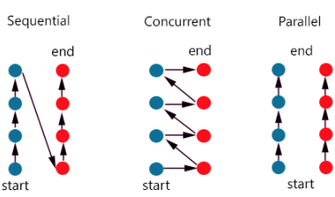

Slide 38
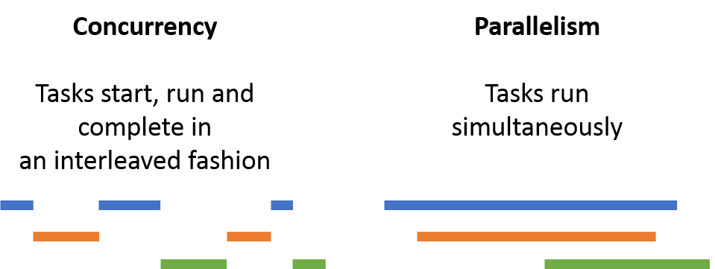

Slide 39

Thoughts
Does it really matter what order you send the requests and save the posters images?

Slide 40
No
Problem is non-deterministic
Concurrency is a good solution
It’s very doable in Go

Slide 41
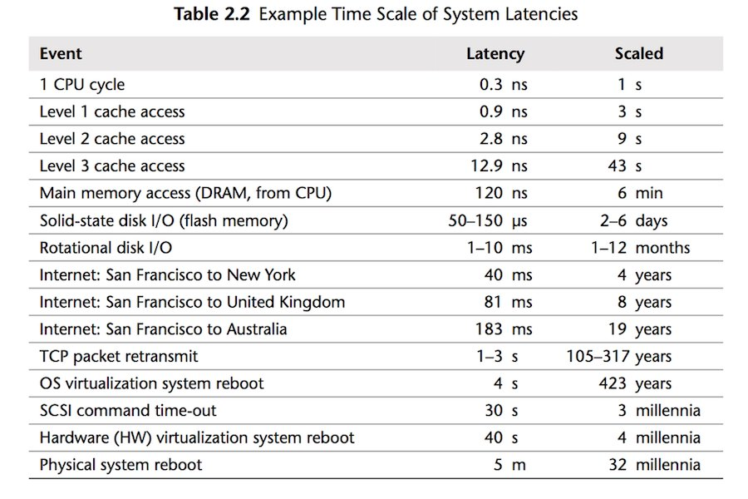
The most important table ever

Slide 42
Concurrency in HTTP requests
Let your CPU care about when the HTTP request is done is
In the meantime, it can process that other response it already received
And write its results to the database

Slide 43
Final assignment
Everything clear?

Slide 44
Please check carefully
That all assignments score 100% in the tests
Getting data from the external API must happen concurrently!

Slide 45
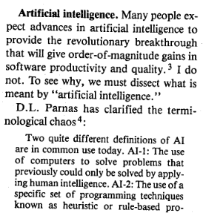
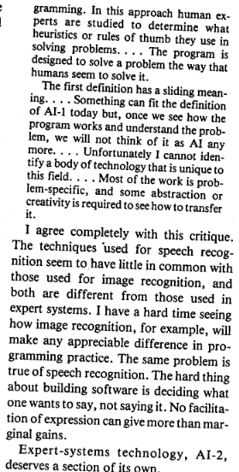
No Silver Bullet

Slide 46
No Silver Bullet
“I have a hard time seeing how image recognition, for example, will make any appreciable difference in programming practice”
Fast forward to 2024 and that’s exactly what happened with Transformers

Slide 47
https://openai.com/index/introducing-canvas/
https://github.com/features/copilot

Slide 48
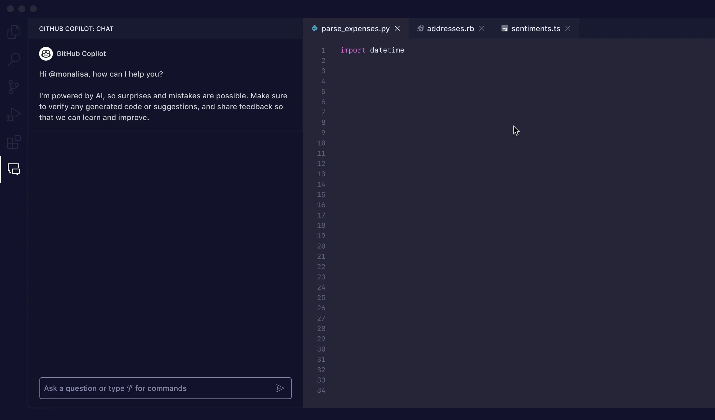

Slide 49
https://www.youtube.com/watch?v=sQYXZCUvpIc

Slide 50
AI tools are cool
Whether they improve your software’s quality…
Is for next lecture ☺
Spoiler alert: lol hell no what did you even expect lmao ahahaha

